Slide 1

G2M Case Study
Virtual Internship
Varshit Manepalli

Slide 2
About
XYZ is a private firm in US.
Due to remarkable growth in the Cab Industry in last few years and multiple key players in the market.
It is planning for an investment in Cab industry.
As per their Go-to-Market(G2M) strategy they want to understand the market before taking final decision.

Slide 3
Data Overview
Total No. of Files : 4
Files Derived(made from merging) : 1
Details :
Cab_Data.csv - this file includes details of transaction for 2 cab companies
City.csv - this file contains list of US cities, their population and number of cab users
Customer_ID.csv - this is a mapping table that contains a unique identifier which links the customer’s demographic details
Transaction_ID.csv - this is a mapping table that contains transaction to customer mapping and payment mode
Data.csv (Derived) – this file is derived from merging the above files, and the merging has happened with the respective primary keys
Time period of data is from 31/01/2016 to 31/12/2018.

Slide 4
Outcome
Determine which cab company offers the best potential for a successful investment based on solid data analysis
Gain insights into which markets and customer segments are most promising for investment.
Learn about the factors that give the chosen cab company a competitive edge in the market.
Uncover potential areas for future expansion and innovation within the cab industry.

Slide 5
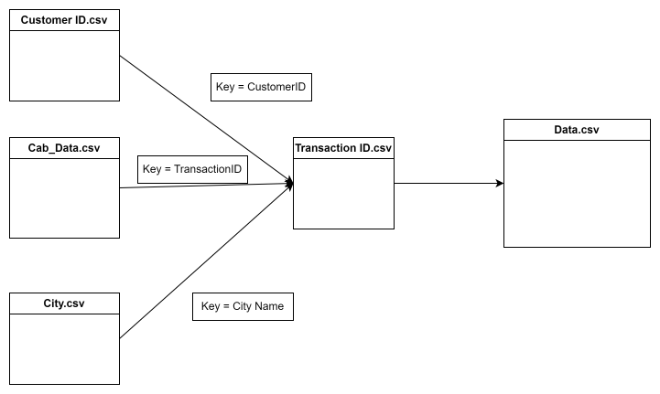
Data Exploration
The merge has been done from the provided data files and a final resulting file has been generated as per the following

Slide 6
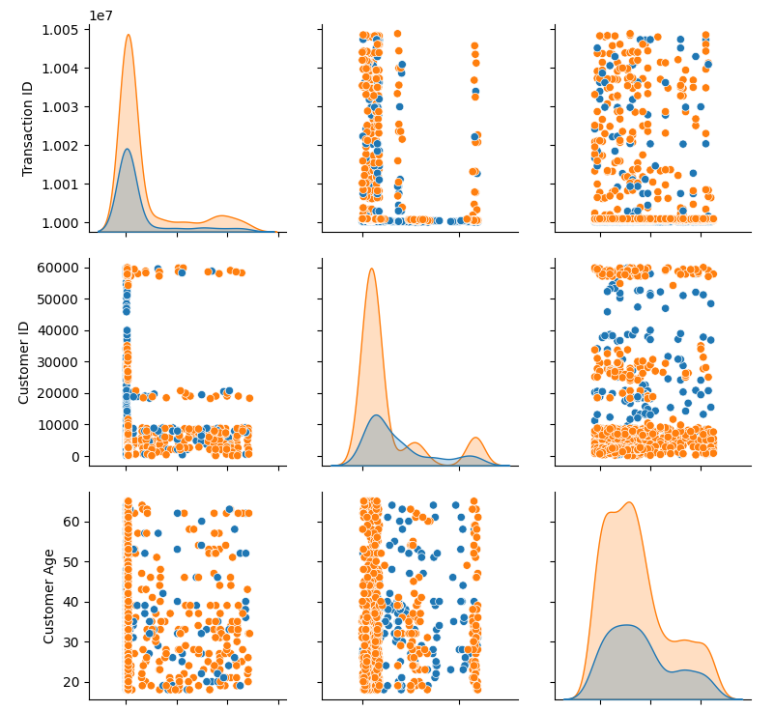
Data Exploration
This image is a part of the pairplot that shows how different factors, such as trip distance, fare amount, and ride duration, interact with each other for the first 1,000 records in our dataset. (Click the image to view the complete image)
Each plot distinguishes between the two cab companies using different colours. This helps us see patterns like which company generally has longer trips or higher fares.
The plots help us spot trends such as increasing fares with longer distances. We can also see if there are any unusual points, such as very long trips with low fares, which might need further investigation.
By understanding these relationships, XYZ can make informed decisions on which company aligns better with market demands or which company's operational traits offer a better investment opportunity.

Slide 7
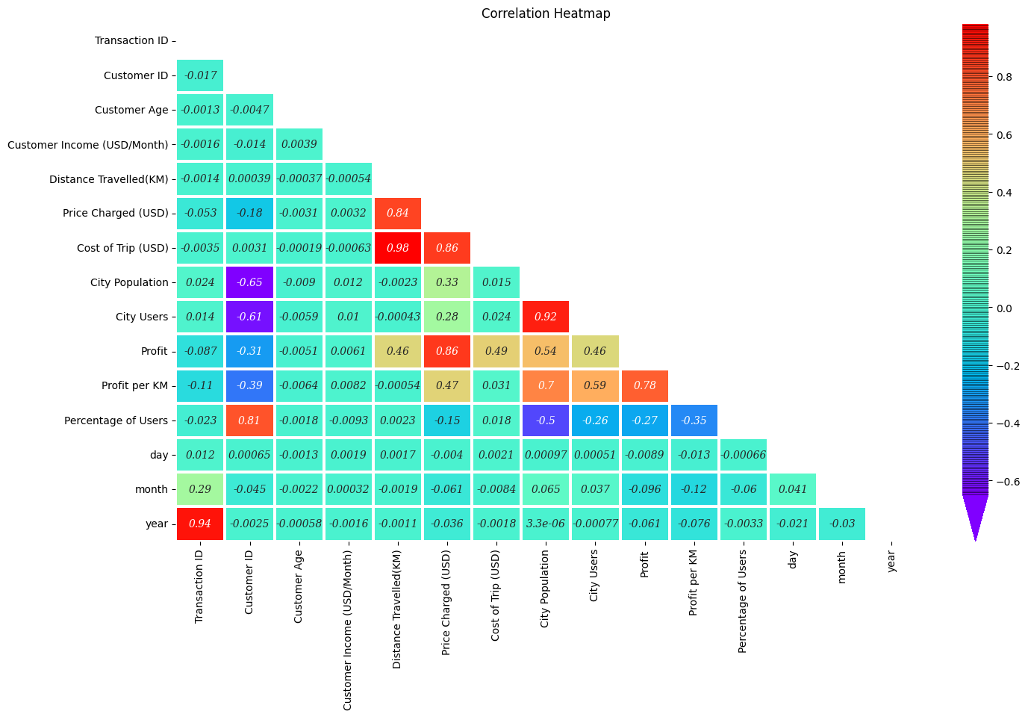
Data Exploration
The image is a correlation heatmap, that shows us how closely related different pieces of information are.
It helps us see which things move together, like if one goes up, does the other tend to as well, or does it go down, or is there no clear pattern at all.
This chart shows us that the year has a negative link with other factors, suggesting a decrease in some measured activities or changes in the data over the years covered.
Distance travelled is strongly linked to the Cost of the trip. So does the Price charged.

Slide 8
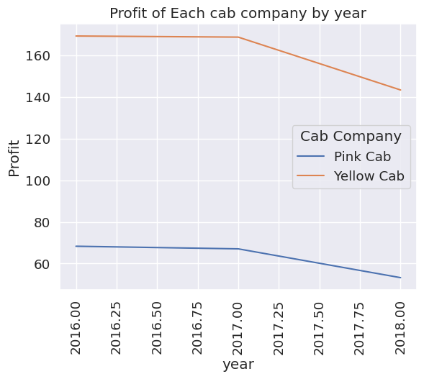
Data Exploration
The graph shows that both Pink Cab and Yellow Cab companies' profits have been decreasing over the years.
While Yellow Cab started off much higher, their profits have been dropping sharply, and Pink Cab, despite lower profits, shows a more gradual decline.

Slide 9
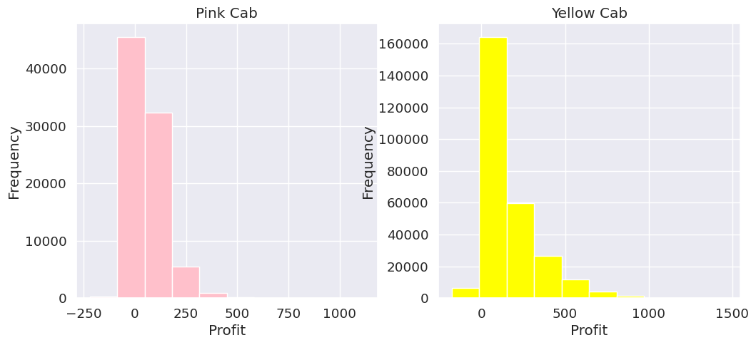
Data Exploration

Slide 10
Data Exploration
The graph in the previous slide compares how often Pink Cab and Yellow Cab earn different amounts of profit.
Most of Pink Cab's profits fall into a smaller range, while Yellow Cab shows a wider range with higher profit peaks.
Pink Cab's profits are frequently around the lower end, suggesting they consistently make smaller amounts.
Yellow Cab, however, while also having a substantial frequency of lower profits, has several instances of much higher profits.

Slide 11
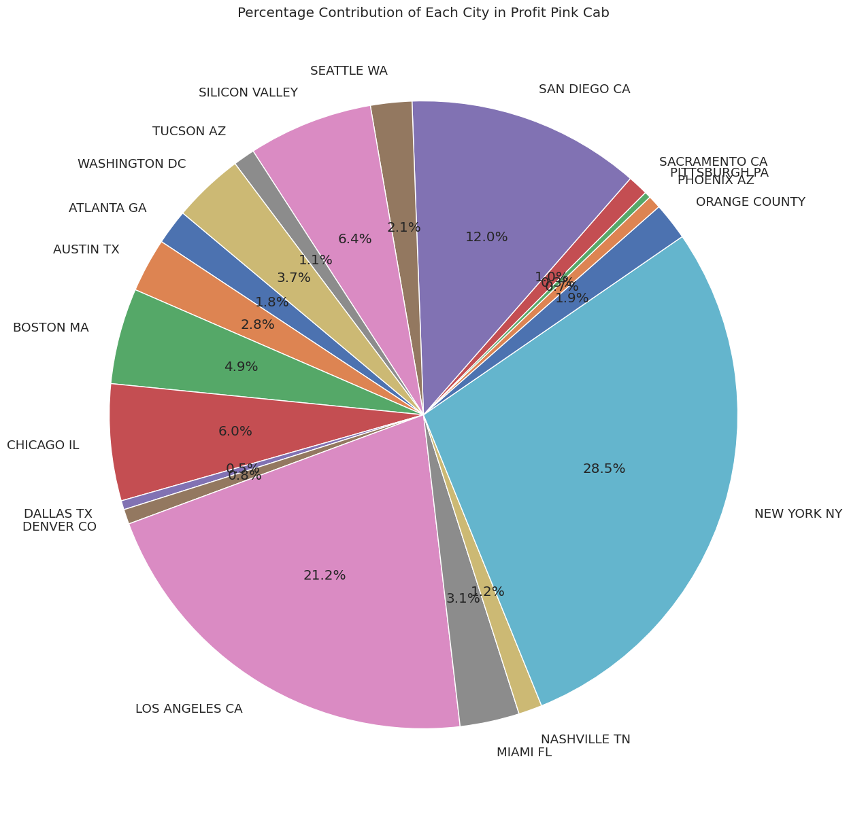
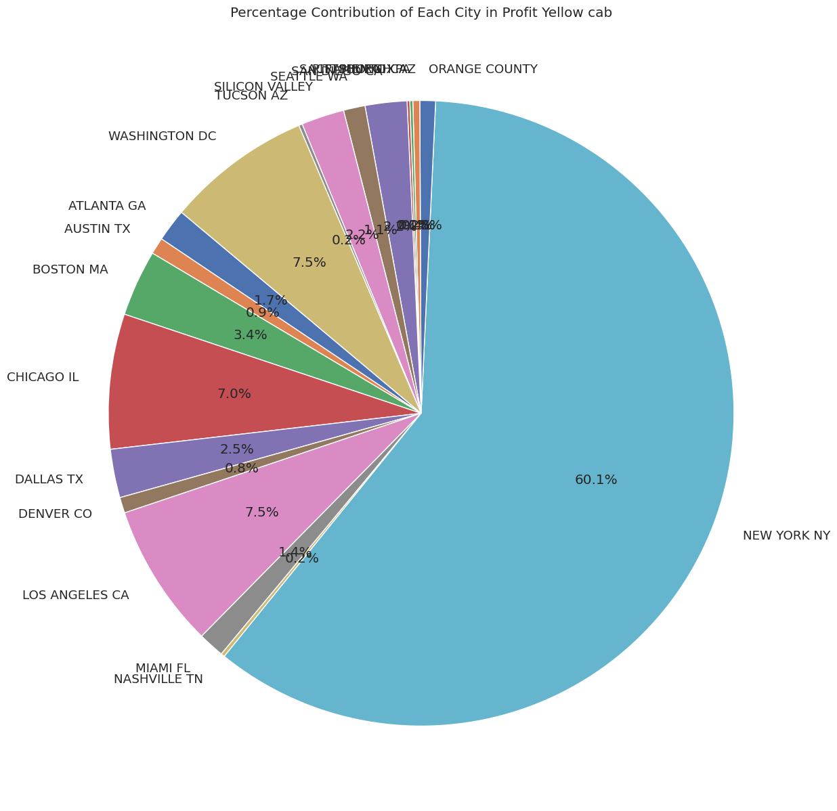
Data Exploration

Slide 12
Data Exploration
The charts in the previous slides show us where each cab company is making its profits across different cities.
Pink Cab has its profits more spread out among various cities, with New York City being its top earner.
Yellow Cab, however, earns a huge portion of its profits from New York City alone.
This difference indicates that Yellow Cab relies heavily on New York City for its profitability, whereas Pink Cab's profit sources are more diverse geographically.

Slide 13
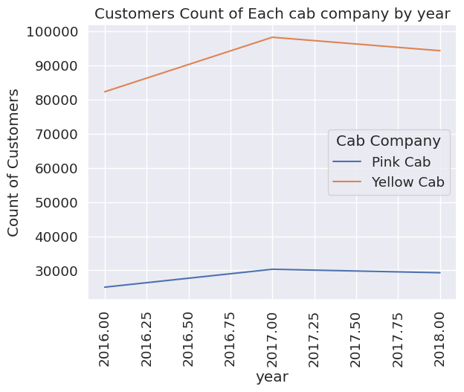
Data Exploration
The line graph shows the number of customers for each cab company over several years. Yellow Cab has consistently had more customers than Pink Cab throughout the years shown.
While the customer base for Yellow Cab has been increasing over time, Pink Cab's customer count shows a slight rise and then levels off, without significant growth.

Slide 14
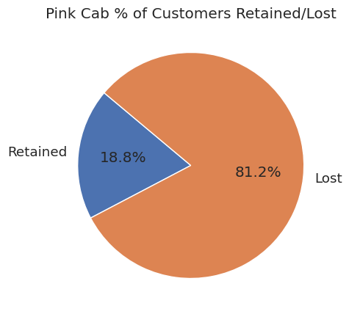
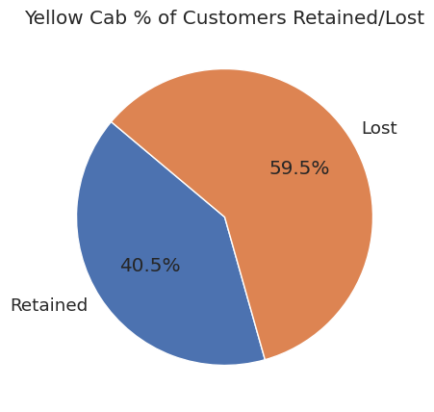
Data Exploration

Slide 15
Data Exploration
The pie charts in the previous slide show how many customers each cab company keeps and loses.
Pink Cab has kept 18.8% of its customers, while Yellow Cab has retained a higher portion, at 40.5%.
This suggests Yellow Cab is better at keeping its customers compared to Pink Cab, with more than half of its customers staying loyal to the service.

Slide 16
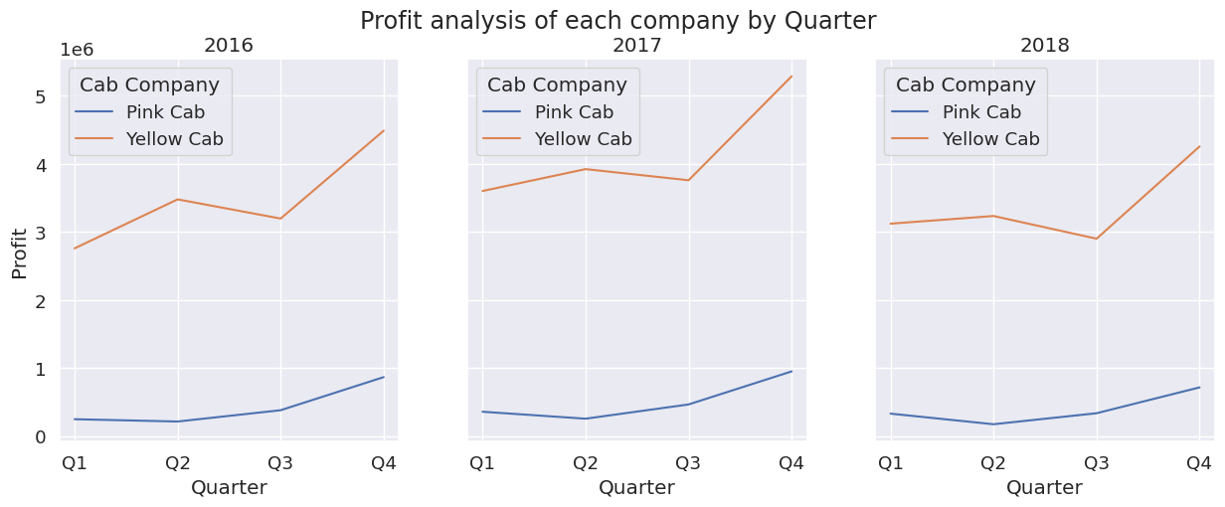
Data Exploration

Slide 17
Data Exploration
The graph in the previous slide shows the profits made by Pink Cab and Yellow Cab over three years, broken down by each quarter.
Yellow Cab consistently earns more profit than Pink Cab in every quarter throughout the three years.
For both companies, the end of the year, especially the fourth quarter, seems to be a peak profit period.
While profits for Pink Cab show slight increases in the last quarters, Yellow Cab’s profits show more significant jumps during the same period.
Over the three years, there's a visible trend of increasing profits for Yellow Cab, while Pink Cab's profit growth is less pronounced.

Slide 18
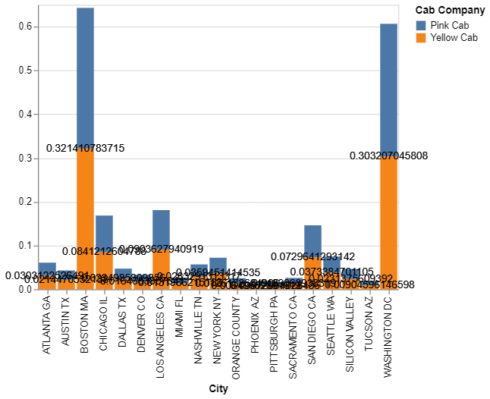
Data Exploration
The graph compares Pink Cab and Yellow Cab in different cities, based on the percentage of users in the respective city.
In nearly all cities, Yellow Cab has higher values than Pink Cab, indicating it either has more rides, greater profits, or a higher measure of another performance metric.
The cities with the highest values for both cab companies are Boston MA for Pink Cab and Washington DC for Yellow Cab, suggesting these cities are strong markets for the respective companies.
For most cities, Yellow Cab's values are significantly larger than those of Pink Cab, implying a stronger presence or performance in those areas.

Slide 19

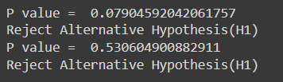
Hypothesis 1
I have checked if the year had anything to do with how much profit the cab companies made.
The math shows it likely doesn't, since our "p value" wasn't small enough to be sure.
This means we can't say for certain that profits go up or down just because the year changes. There might be other reasons for why profits vary.

Slide 20
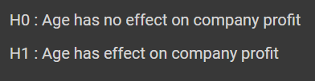

Hypothesis 2
We tried to see if a customer's age affects how much profit a cab company makes.
The results show that age probably doesn't have an effect because the p values are high.
So, when it comes to profits, it doesn't matter whether customers are young or old, as far as we can tell from the data.

Slide 21
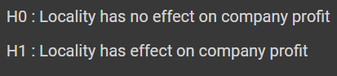
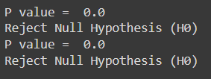
Hypothesis 3
We looked at whether the city where a cab company operates can influence its profits. The p value which is very low leads us to believe that the city does indeed have an effect on profits.
So, based on our tests, where the company is located is important for its profits different cities can mean different profit levels for the company.

Slide 22


Hypothesis 4
We checked if the time of year, divided into quarters, changes how many customers use cabs.
The p value was very low, so we think there is a connection.
This means the number of cab users might go up or down depending on the time of year, like during holidays or different seasons.

Slide 23


Hypothesis 5
We looked at whether how customers pay — like by cash or card — affects a company’s profits for the year.
The p values are very high, which tells us payment method likely doesn't make a difference.
So, it seems the company's profits aren't really affected by the different ways customers choose to pay.

Slide 24
Recommendations
Profit Trends Over Time : Yellow Cab consistently shows higher profitability across multiple years when compared to Pink Cab, suggesting a stronger overall financial performance.
Customer Retention : Yellow Cab has a higher percentage of customer retention, indicating a loyal customer base, which is a valuable asset for sustainable growth and long-term profitability.
Market Presence by City: Yellow Cab’s profit distribution indicates a significant market presence in key cities, particularly in Washington DC, which can be leveraged for further expansion and market penetration.
Seasonal Variations : Yellow Cab’s profits show significant seasonal variations, which could indicate a successful adaptation to market demands during peak times, such as holidays or events, presenting opportunities for strategic marketing campaigns.
Influence of City Location: There’s evidence to suggest that the location, or the city in which a cab company operates, significantly affects profit levels. Yellow Cab’s strong performance in multiple cities shows its ability to capitalize on diverse market dynamics.
Based on these points, and especially considering Yellow Cab's stronger profitability and customer retention, it would seem that Yellow Cab presents a more attractive investment opportunity for XYZ company.
However, It would also be prudent to consider additional factors such as operational costs, market trends, and potential regulatory changes in the industry.

Slide 25
Thank You

